Slide 1
SEGR 5910
DevOps from the Architect’s Perspective

Slide 2
Logistics
Everybody needs docker installed locally
Make sure you have run docker run hello-world

Slide 3
Outline
Introduction to containers
Hands on Docker
What’s left?

Slide 4
Goal of containers
Want to package executable such that it
Is isolated from other executables
Is lightweight in terms of loading and transferring
Is repeatable across deployments

Slide 5
Isolation
Process
Isolate address space
No isolation for files or networks
Lightweight
Virtual Machine
Isolate address space
isolate files and networks
Heavyweight

Slide 6
Containers
Process
Isolate address space
No isolation for files or networks
Lightweight
Container
Isolate address space
isolate files and networks
Lightweight
Virtual Machine
Isolate address space
isolate files and networks
Heavyweight

Slide 7
Trade offs
Virtual machine gives you all the freedom you have with bare metal
Choice of operating system
Total control over networking arrangement and file structures
Container is constrained in terms of operating systems available
Provides limited networking options
Provides limited file structuring options

Slide 8
VMs and Containers
App1
App2
App3
Binaries / Libraries
Binaries / Libraries
Binaries / Libraries
App1
App2
App3
Guest OS 1
Guest OS 2
Guest OS 3
Binaries / Libraries
Binaries / Libraries
Binaries / Libraries
Container Runtime
Virtual Machine Manager
Host Operating System
Hardware
Hardware

Slide 9
VMS vs containers
VMs are virtualized hardware.
Each VM can run its own OS.
All OSs and apps use same instruction set
VM manager is hypervisor
Each VM has its own IP address
Containers are virtualized operating system.
Each container can use its own binaries and libraries
All apps use same OS
Container manager is, for example, “Docker Engine”
Each container has its own IP address

Slide 10
Portability
Containers are portable across platforms as long as the container runtime is the same.
This allows a container to be moved from one environment to another.

Slide 11
VMs and containers can be combined
App1
App2
App3
Binaries / Libraries
Binaries / Libraries
Binaries / Libraries
Container
Runtime 1
Container Runtime 2
Guest OS 1
Guest OS 2
Virtual Machine Manager
Hardware

Slide 12
Container component interactions
Registry
Image A
Image B
Image C
Orchestrator
Container 1
Container 2
Container 3
Container
Runtime 1
Container
Runtime 2
Guest OS 1
Guest OS 2
Container 4
Container 5
Container 6
Container 7
Container 8
Container 9
Container Runtime
Container Runtime
Virtual Machine Manager
Host Operating System
Host Operating System
Hardware
Hardware
Hardware

Slide 13
Outline
Introduction to containers
Hands on Docker
What’s left?

Slide 14
Demo time
Follow along at home

Slide 15
What have we seen
Distinction between docker images and containers
Creating a docker image in layers
Provisioning the docker image from the internet
Executing pre-built app

Slide 16
End of hands on – back to theory
Docker Higher Education Guide
https://docs.google.com/document/d/1meLrrov1vWE7dzyy0RxbKxDLmmqzx0IA4NG3wSFsg7Q/edit

Slide 17
Layers
A Docker container image is structured in terms of “layers”.
Process for building image
Start with base image
Load software desired
Commit base image + software to form new image
New image can then be base for more software
Image is what is transferred

Slide 18
Loading of software
OS is ~ 1GB(yte)
Fast network is ~ 1Gb(it) rated
Since there are 8 bits per byte, transferring an OS should take 8 seconds.
But a 1Gb rated network is ~35Mb in practice
This means loading an OS is >30 seconds
Consequently, sharing an OS saves >30 seconds per instance. Sharing other software saves more
Notes:
http://www.tomshardware.com/reviews/gigabit-etherne-bandwidth,2321-3.html

Slide 19
Exploiting layers
When an image is updated, only update new layers
Unchanged layers do not need to be updated
Consequently, less software is transferred and an update is faster.

Slide 20
Outline
Introduction to containers
Hands on Docker
What’s left?

Slide 21
What is left?
Scripting
Sharing of images
Scaling of images
AWS container service
Lambda

Slide 22
Scripting
Creating an image by hand is tedious and error prone
You can create a script to do this (Dockerfile).

Slide 23
Sharing image
Multiple team members may wish to share images
Images can be in production, under development or under test
Docker Hub is a repository where images can be stored and shared.
Each image is tagged to allow versioning
Any image can be “pulled” to any host (with appropriate credentials)
Tagging as “latest” allows updates to be propagated. Pull <image name>:latest gets the last image checked into repository with that name.

Slide 24
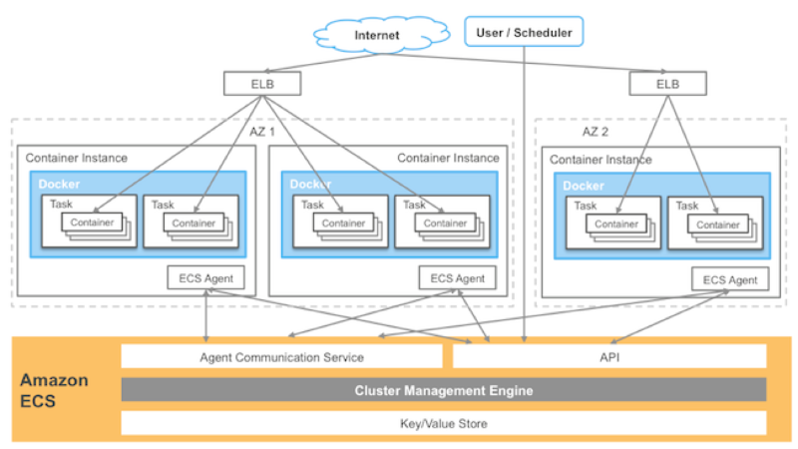
AWS EC2 container management

Slide 25
AWS Lambda
AWS also has a facility called “Lambda” that consists of preloaded OS + execution engines. Exists for
Java
Node.js
Python
C#
AWS maintains pool of partially loaded containers that only require app specific layer.
Load in micro secs.
Only one request per Lambda instance

Slide 26
Summary
A container is a lightweight virtual machine that provides address space, network, file isolation
Docker allows building images in layers and deployment of a new version just requires deploying layers that have changed.
Containers can be managed either on VMs through autoscaling or on preallocated pool for short duration, quick loading
Development workflow is supported through an image repository.

Slide 27
Next week

